Slide 1
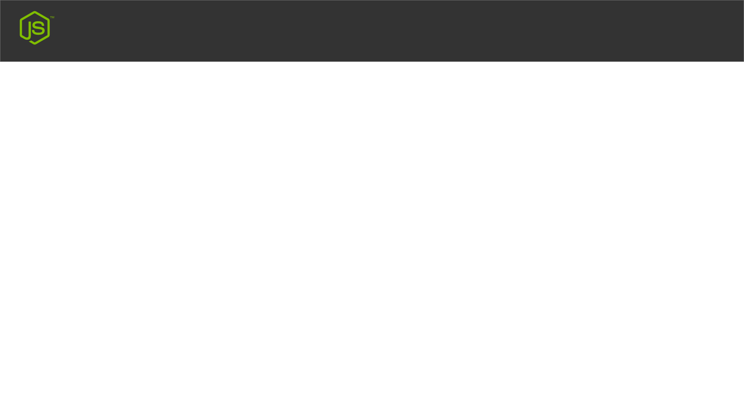
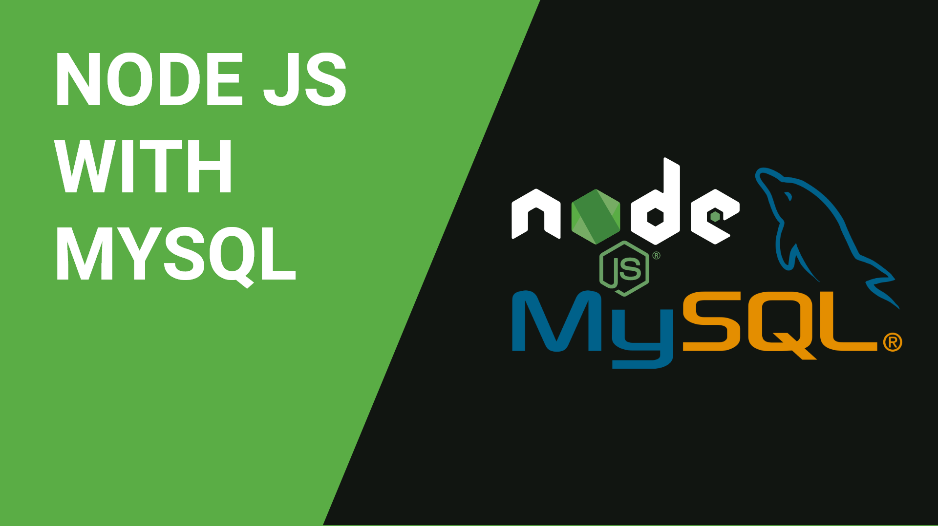
Node JS With MYSQL
MY FIRST NODE JS WEBSITE
Create & Deploy In Real Server

Slide 2
Node JS With MYSQL
Tools Required
Node JS
Xammp

Slide 3
Node JS With MYSQL
Create New Project For Practice

